Slide 1









My Number Interactive Notebook
$$×$$
$$\frac{1}{2}$$
$$÷$$
$$+$$
$$−$$
$$\frac{3}{5}$$
$$7$$
Name
Class
Teacher
Term 1 Semester 1
$$5^{2}$$
$$\sqrt{9}$$
1

Slide 2
Create your own front page
It needs to contain the following –
My number interactive notebook
Name
Class
Teachers Name
Semester 1 Term 1
Page number 1

Slide 3
Contents
Glossary or Formula Page
Page
Date
Description
2
3

Slide 4
Tasks
24
7
30
Essential Question
Questions
Notes
Summary
4
5

Slide 5
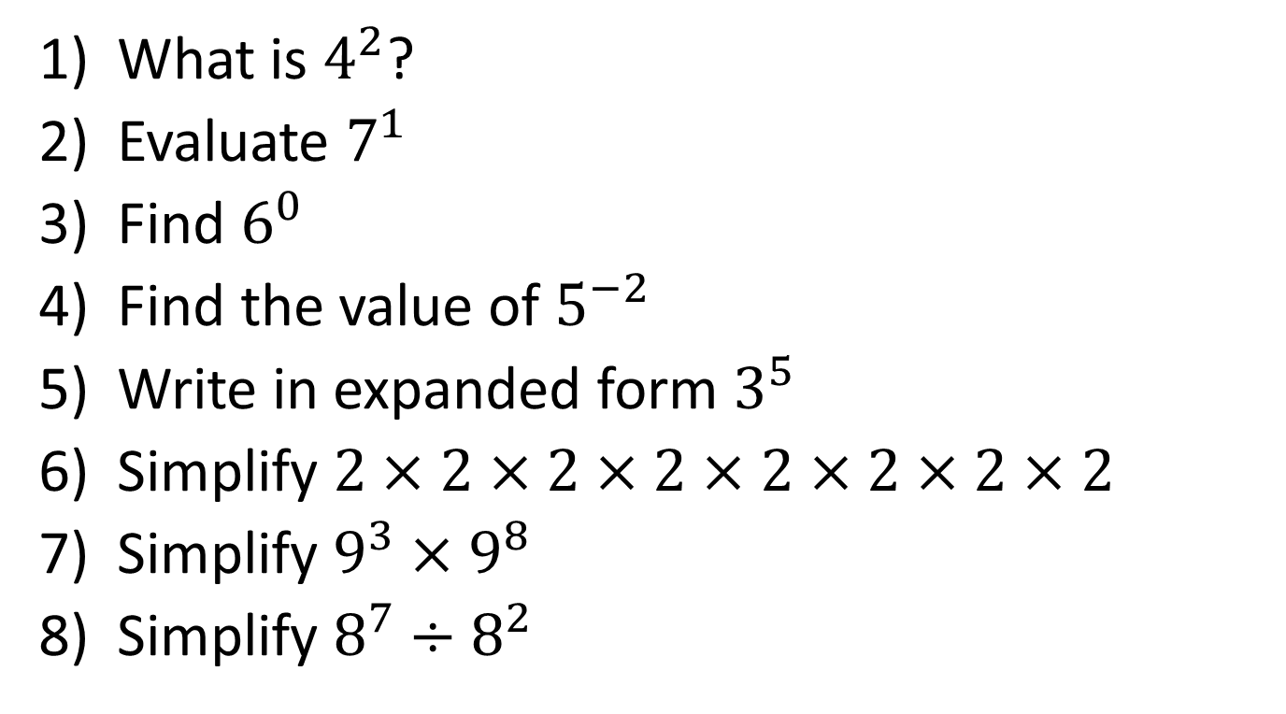
Task One – Show me boards
What is $4^{2}$?
Evaluate $7^{1}$
Find $6^{0}$
Find the value of $5^{−2}$
Write in expanded form $3^{5}$
Simplify $2×2×2×2×2×2×2×2$
Simplify $9^{3}×9^{8}$
Simplify $8^{7}÷8^{2}$

Slide 6
24
7
30
Date
Index Notation
EQ – How do I calculate the value of a number to the power of a positive or negative integer?
5

Slide 7

24
7
30
Date
Index Notation
EQ – How do I calculate the value of a number to the power of a positive or negative integer?
What is index notation?
Index or exponent
Base
$$3^{5}=3×3×3×3×3$$
5

Slide 8

24
7
30
Date
Index Notation
EQ – How do I calculate the value of a number to the power of a positive or negative integer?
What is index notation?
Index or exponent
Base
$$3^{5} =3×3×3×3×3$$
Power Form
or index form
5

Slide 9
24
7
30
Date
Index Notation
EQ – How do I calculate the value of a number to the power of a positive or negative integer?
What is index notation?
Index or exponent
Base
$$3^{5} =3×3×3×3×3$$
Power Form
or index form
Extended or expanded form
5

Slide 10
24
7
30
Date
Index Notation
EQ – How do I calculate the value of a number to the power of a positive or negative integer?
What is index notation?
Index or exponent
Base
$$3^{5} =3×3×3×3×3$$
Power Form
or index form
Extended or expanded form
The index shows the number of times the base is multiplied by itself
5

Slide 11

Task – Write in expanded form and find the value
$2^{5}$=
$2^{4}$=
$2^{3}$=
$2^{2}$=
$2^{1}=$

Slide 12

Task – Write in expanded form and find the value
$2^{5}$=
$2^{4}$=
$2^{3}$=
$2^{2}$=
$2^{1}=$
Look at the pattern- Can you find the value of
$2^{0}$
$2^{−1}$
$2^{−2}$

Slide 13

Task – Write in expanded form and find the value
$2^{5}=2×2×2×2×2$
$2^{4}$=
$2^{3}$=
$2^{2}$=
$2^{1}=$
Look at the pattern- Can you find the value of
$2^{0}$
$2^{−1}$
$2^{−2}$

Slide 14

Task – Write in expanded form and find the value
$2^{5}=2×2×2×2×2=32$
$2^{4}$=
$2^{3}$=
$2^{2}$=
$2^{1}=$
Look at the pattern- Can you find the value of
$2^{0}$
$2^{−1}$
$2^{−2}$

Slide 15

Task – Write in expanded form and find the value
$2^{5}=2×2×2×2×2=32$
$2^{4}=2×2×2×2$
$2^{3}$=
$2^{2}$=
$2^{1}=$
Look at the pattern- Can you find the value of
$2^{0}$
$2^{−1}$
$2^{−2}$

Slide 16

Task – Write in expanded form and find the value
$2^{5}=2×2×2×2×2=32$
$2^{4}=2×2×2×2$ $=16$
$2^{3}$
$2^{2}$=
$2^{1}=$
Look at the pattern- Can you find the value of
$2^{0}$
$2^{−1}$
$2^{−2}$

Slide 17

Task – Write in expanded form and find the value
$2^{5}=2×2×2×2×2=32$
$2^{4}=2×2×2×2$ $=16$
$2^{3}=2×2×2$
$2^{2}$=
$2^{1}=$
Look at the pattern- Can you find the value of
$2^{0}$
$2^{−1}$
$2^{−2}$

Slide 18
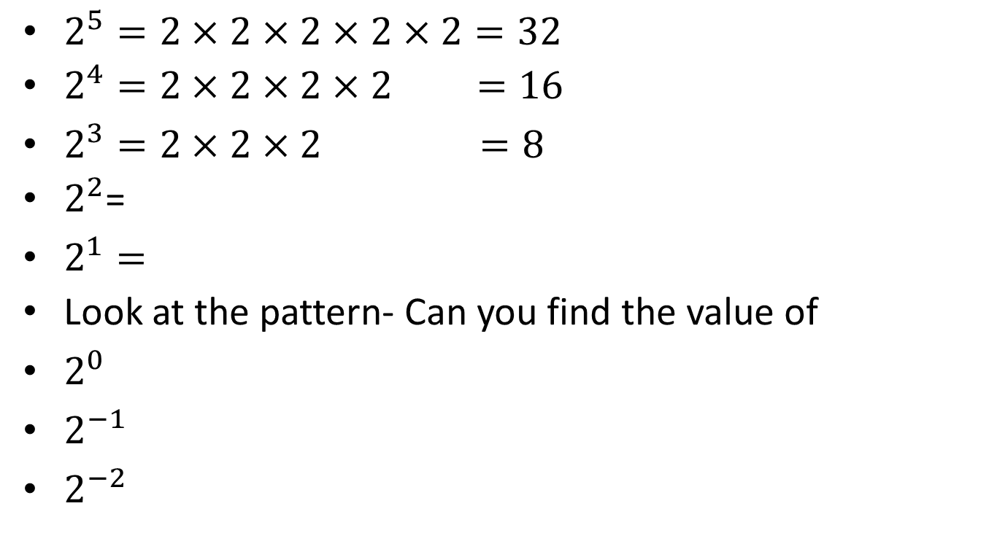
Task – Write in expanded form and find the value
$2^{5}=2×2×2×2×2=32$
$2^{4}=2×2×2×2$ $=16$
$2^{3}=2×2×2 =8$
$2^{2}$=
$2^{1}=$
Look at the pattern- Can you find the value of
$2^{0}$
$2^{−1}$
$2^{−2}$

Slide 19
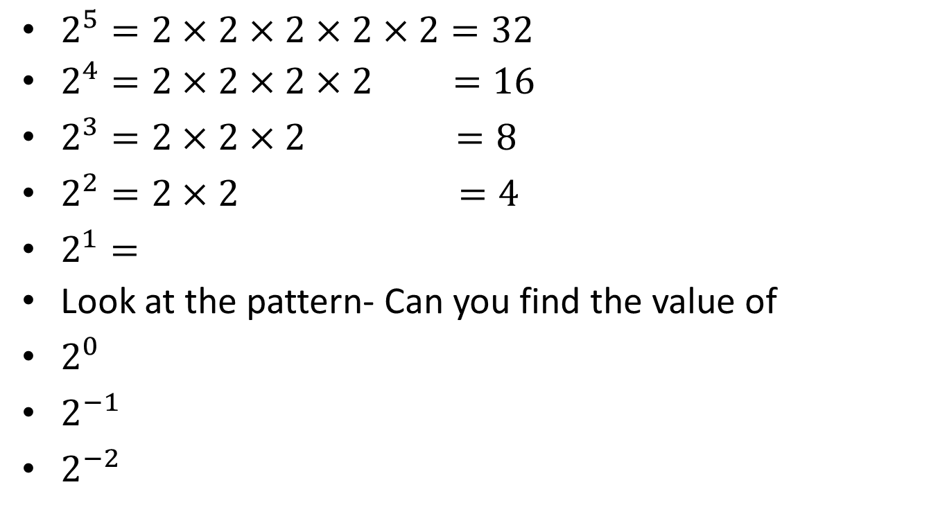
Task – Write in expanded form and find the value
$2^{5}=2×2×2×2×2=32$
$2^{4}=2×2×2×2$ $=16$
$2^{3}=2×2×2 =8$
$2^{2}=2×2 =4$
$2^{1}=$
Look at the pattern- Can you find the value of
$2^{0}$
$2^{−1}$
$2^{−2}$

Slide 20
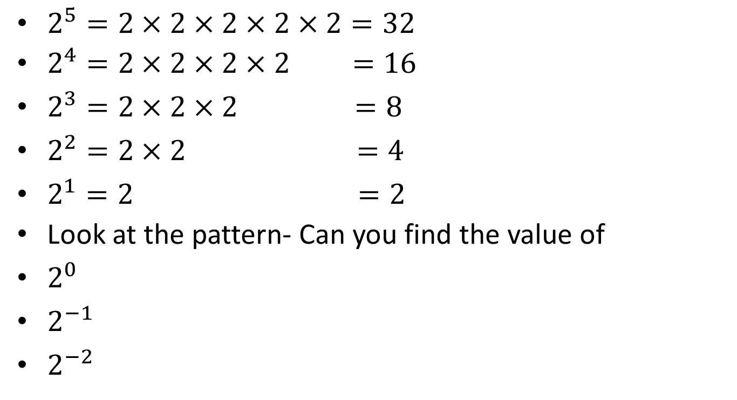
Task – Write in expanded form and find the value
$2^{5}=2×2×2×2×2=32$
$2^{4}=2×2×2×2$ $=16$
$2^{3}=2×2×2 =8$
$2^{2}=2×2 =4$
$2^{1}=2 =2$
Look at the pattern- Can you find the value of
$2^{0}$
$2^{−1}$
$2^{−2}$

Slide 21
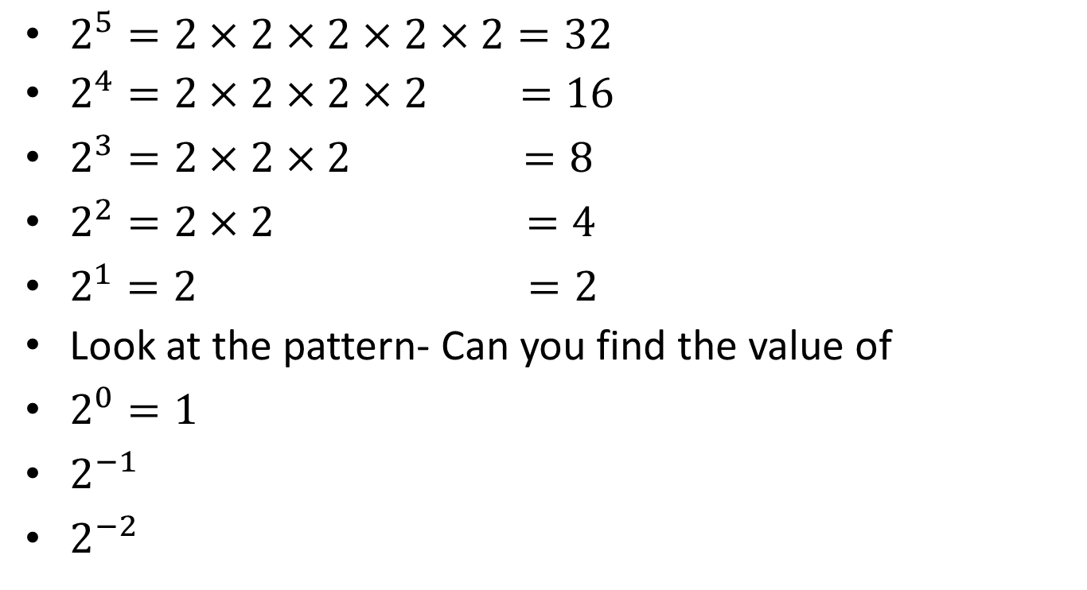
Task – Write in expanded form and find the value
$2^{5}=2×2×2×2×2=32$
$2^{4}=2×2×2×2$ $=16$
$2^{3}=2×2×2 =8$
$2^{2}=2×2 =4$
$2^{1}=2 =2$
Look at the pattern- Can you find the value of
$2^{0}=1$
$2^{−1}$
$2^{−2}$

Slide 22
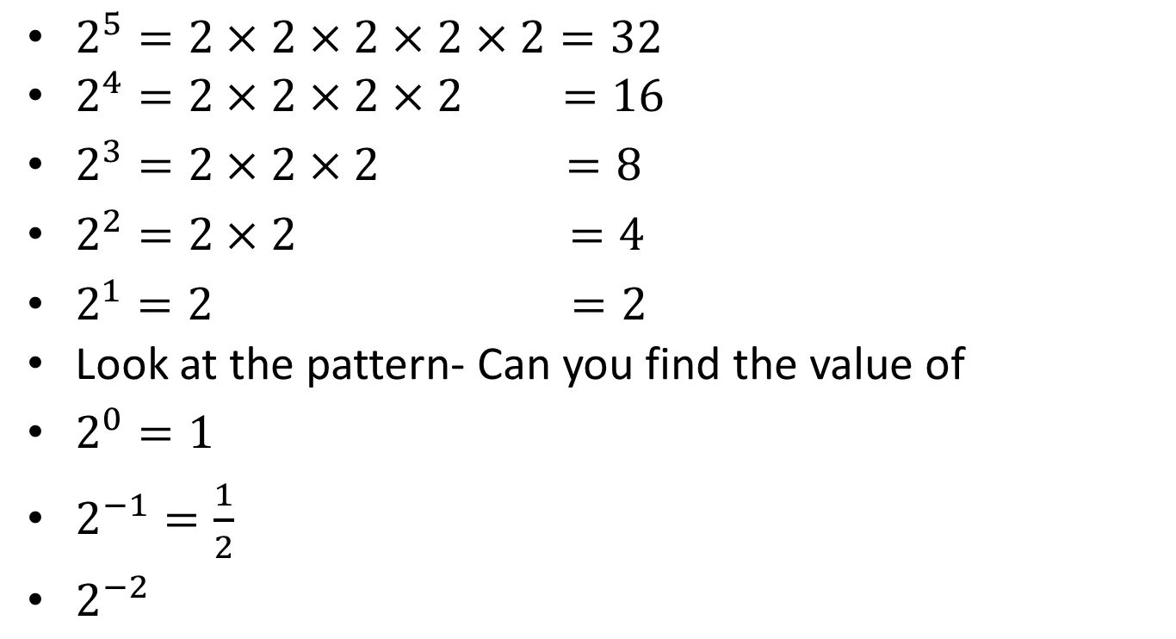
Task – Write in expanded form and find the value
$2^{5}=2×2×2×2×2=32$
$2^{4}=2×2×2×2$ $=16$
$2^{3}=2×2×2 =8$
$2^{2}=2×2 =4$
$2^{1}=2 =2$
Look at the pattern- Can you find the value of
$2^{0}=1$
$2^{−1}=\frac{1}{2}$
$2^{−2}$

Slide 23
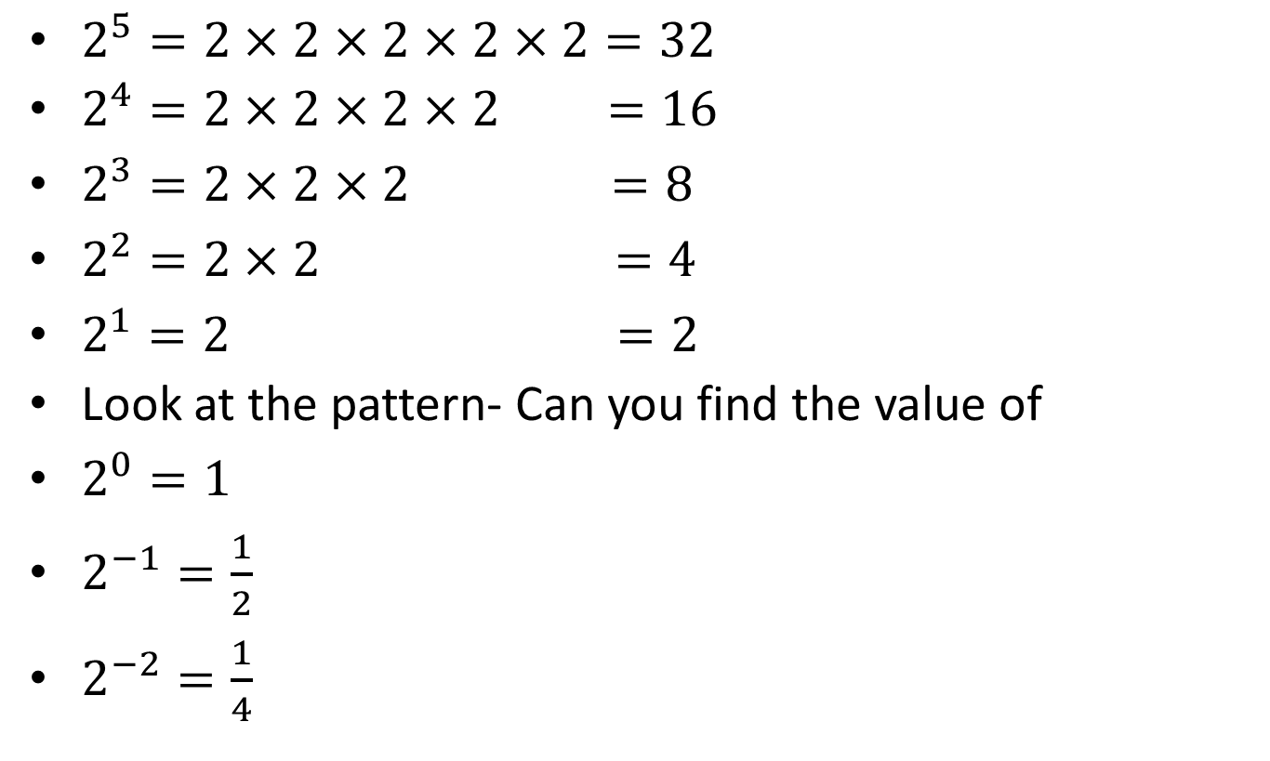
Task – Write in expanded form and find the value
$2^{5}=2×2×2×2×2=32$
$2^{4}=2×2×2×2$ $=16$
$2^{3}=2×2×2 =8$
$2^{2}=2×2 =4$
$2^{1}=2 =2$
Look at the pattern- Can you find the value of
$2^{0}=1$
$2^{−1}=\frac{1}{2}$
$2^{−2}=\frac{1}{4}$

Slide 24
24
7
30
Date
Index Notation
EQ – How do I calculate the value of a number to the power of a positive or negative integer?
What is index notation?
Index or exponent
Base
$$3^{5} =3×3×3×3×3$$
Power Form
or index form
Extended or expanded form
The index shows the number of times the base is multiplied by itself
How to you evaluate a base to the power of one or zero?
5

Slide 25

24
7
30
Date
Index Notation
EQ – How do I calculate the value of a number to the power of a positive or negative integer?
What is index notation?
Index or exponent
Base
$$3^{5} =3×3×3×3×3$$
Power Form
or index form
Extended or expanded form
The index shows the number of times the base is multiplied by itself
How to you evaluate a base to the power of one or zero?
$$a^{1}=a e.g. { 12}^{1}=12$$
5

Slide 26

24
7
30
Date
Index Notation
EQ – How do I calculate the value of a number to the power of a positive or negative integer?
What is index notation?
Index or exponent
Base
$$3^{5} =3×3×3×3×3$$
Power Form
or index form
Extended or expanded form
The index shows the number of times the base is multiplied by itself
How to you evaluate a base to the power of one or zero?
$$a^{1}=a e.g. { 12}^{1}=12$$
$$a^{0}=1 e.g. { 15}^{0}=1$$
5

Slide 27


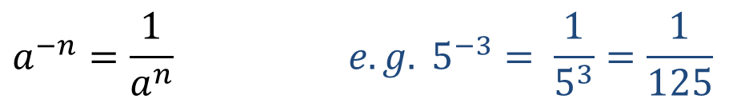
24
7
30
Date
Index Notation
EQ – How do I calculate the value of a number to the power of a positive or negative integer?
How to you evaluate a base to the power of one or zero?
$$a^{1}=a e.g. { 12}^{1}=12$$
$$a^{0}=1 e.g. { 15}^{0}=1$$
What happens if the index is negative?
$$a^{−n}=\frac{1}{a^{n}} e.g. 5^{−3}= \frac{1}{5^{3}}=\frac{1}{125}$$
5

Slide 28
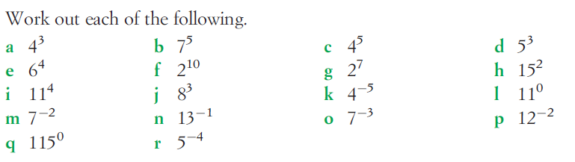
Task

Slide 29
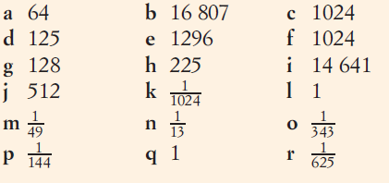
Task
Answers

Slide 30
Notes Review
24, 7 ,30
Date
Title
Essential question
Notes complete
Notes complete with colour and diagrams
Questions completed
Contents page filed in
Formula page filled in

Slide 31
Homework
Review your notes and write a summary answering the essential question.

